Slide 1


Deep Learning for Visual Data
Presented by :
Bin Huang - 8391865
Brain Tumor MRI Classification
ViT vs. ResNet-50
Notes:
Good evening. I'm Bin Huang, and for my Applied Vision Transformer Report I compared a Vision Transformer against a ResNet-50 baseline on a brain tumor MRI classification task. I’ll be walking you through the problem, what I built, and more importantly what went wrong and what that tells us.

Slide 2


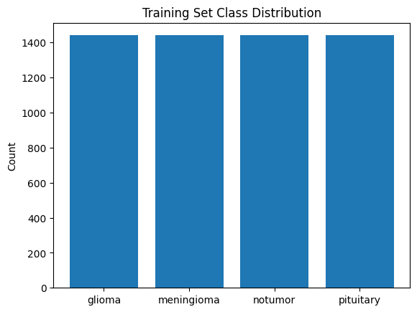
Deep Learning for Visual Data
The problem:
Classify 4 classes of brain MRI: glioma, meningioma, pituitary, no tumor
The dataset:
Kaggle Brain Tumor MRI: 7,200 slices, perfectly balanced
Why it Matters:
False negatives are catastrophic, false positives are a second scan
Today’s Agenda
Notes:
The task is four-way classification of brain MRI slices: glioma, meningioma, pituitary tumor, and a 'no tumor' control. The dataset is 7,200 images, perfectly balanced at 1,800 per class, which I split 80/10/10, stratified, with a fixed seed.
I picked this task because the risk is asymmetric. A false negative — telling a patient with a glioma that they're healthy — is catastrophic. A false positive is just a second scan. That asymmetry is the whole reason I chose to evaluate on recall and the confusion matrix, not just accuracy.

Slide 3
Deep Learning for Visual Data
Baseline:
ResNet-50, ImageNet-1k
Transformer
ViT-B/16, google/vit-base-patch16-224-in21k
Same head:
4-class linear layer, trained from scratch
Same setup:
Colab T4, mixed precision, AdamW, early stopping
What
I Built
Notes:
I compared two models. The baseline is ResNet-50, pretrained on ImageNet-1k. The main model is ViT-B/16, specifically the 21k-pretrained checkpoint, which treats the image as 196 patches and uses self-attention from the first layer.
For both, I replaced the classification head with a 4-class linear layer and trained on the same stratified split. The training setup was AdamW — learning rate 1e-4 for ResNet and 2e-5 for ViT, deliberately lower to avoid catastrophic forgetting — mixed precision on a Colab T4, and early stopping on validation accuracy.
The interesting part of training was the speed. ResNet hit 95% validation accuracy in the first epoch; ViT started at 92% and caught up by epoch 8. But ViT took almost twice as long per epoch — 51 seconds versus 29.

Slide 4

The Headline Result
01
ResNet-50, ImageNet-1k
02
ViT-B/16
98.33% accuracy, 0.9834 macro-F1
12 errors each out of 720
98.33% accuracy, 0.9834 macro-F1
12 errors each out of 720

Slide 5
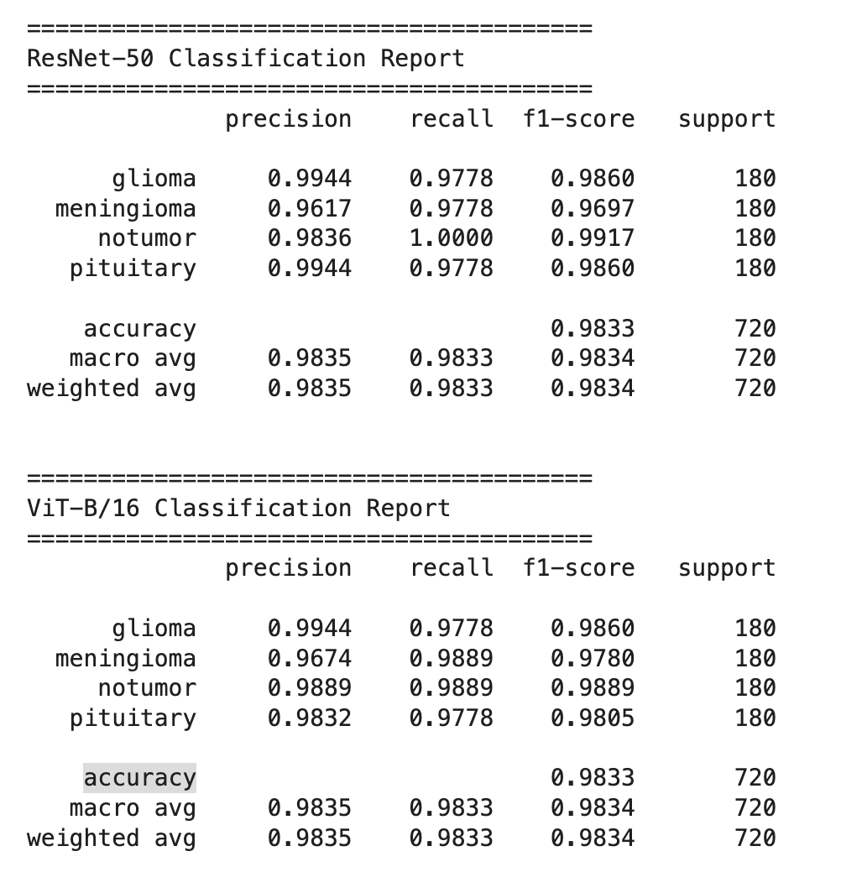
The Headline Result
Notes:
Here's the headline: both models scored exactly the same. 98.33% accuracy, 0.9834 macro-F1, twelve errors out of 720 test images. If I'd stopped here, the conclusion would be 'the architectures are equally effective.'
But the rubric — and the medical context — says accuracy isn't the metric that matters. So I broke the errors down by class, and that's where the two models diverge.

Slide 6
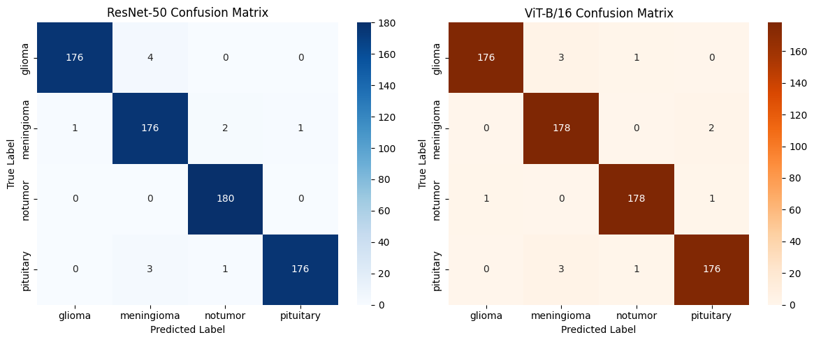
The Headline Result
Notes:
Here's the headline: both models scored exactly the same. 98.33% accuracy, 0.9834 macro-F1, twelve errors out of 720 test images. If I'd stopped here, the conclusion would be 'the architectures are equally effective.'
But the rubric — and the medical context — says accuracy isn't the metric that matters. So I broke the errors down by class, and that's where the two models diverge.

Slide 7
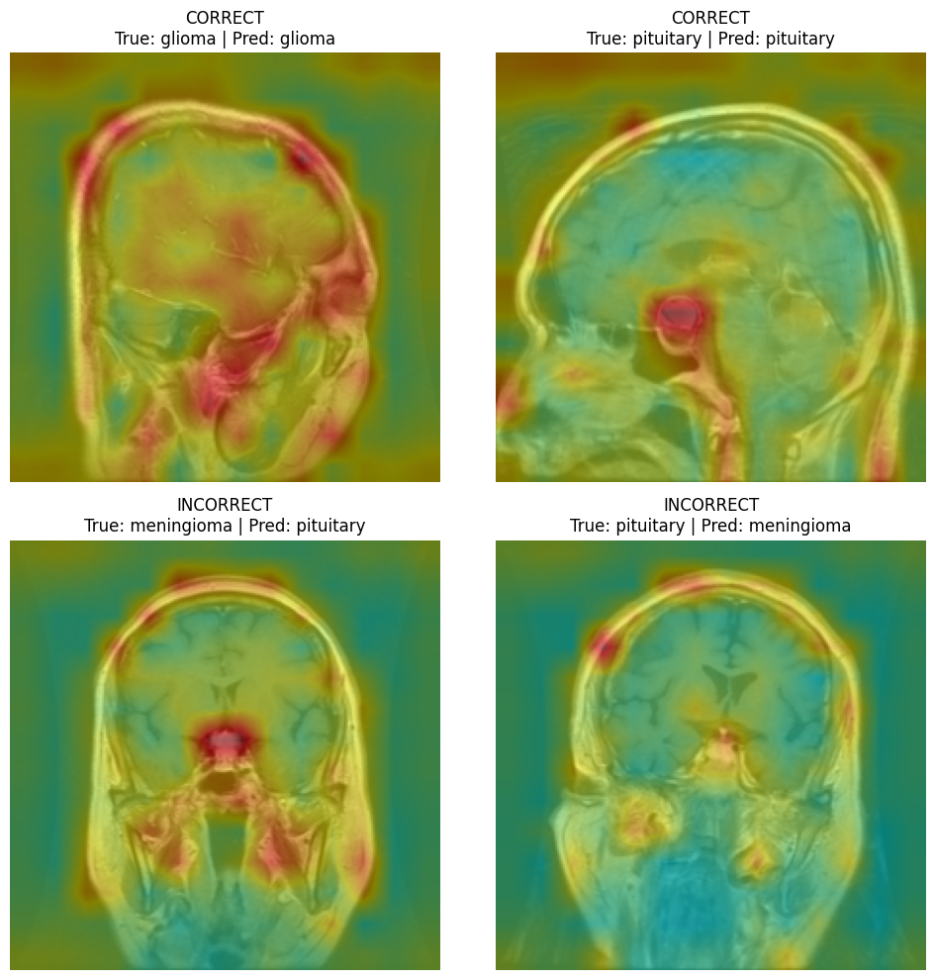
Errors and Attention
Notes:
Two things matter here. First, the error profiles are not identical. ResNet missed 3 actual tumors by predicting 'no tumor' — 2 meningiomas and 1 pituitary. ViT missed 2 — 1 glioma and 1 pituitary. So on the metric that matters most clinically, the ViT is marginally safer.
Second, the attention rollout tells a less flattering story. Here's a glioma the ViT classified correctly. The heatmap is red on the outer edge of the skull and the background — not on the tumor. The model is right, but it's right for the wrong reason. It's using the shape of the head and the image border as a shortcut, not the pathology. That's a bias in how it learned, and it's visible in the rollout.
And there's a third finding I want to mention: both models made 5 confident-wrong errors, but zero of those were confident false negatives. That's actually the most clinically useful result in the project — it means a hospital could flag low-confidence 'no tumor' predictions and defer them to a radiologist.

Slide 8
The Ethical Problem
Data Leakage:
image-level split, no patient IDs → 98.33% is inflated
Demographic invisibility:
no age, gender, ethnicity, or scanner metadata → no fairness audit possible
Automation bias:
a 98% tool can make doctors second-guess themselves
Verdict:
triage aid only, never autonomous
Notes:
The most important thing I found is actually an ethical problem, not a technical one. The Kaggle dataset gives 2D slices with no patient identifiers. Because I split at the image level, contiguous slices from the same patient's scan almost certainly ended up in both training and test sets. That means the 98.33% is inflated — the models are partly memorising patient anatomy. The attention rollout is the visual proof.
Second, there's no metadata — no age, no sex, no ethnicity, no scanner information. I can't run a fairness audit, and deploying an unaudited model risks amplifying existing biases.
Third, automation bias. If a tool says 98%, doctors may second-guess their own judgment. Combined with confident-wrong errors, that's a real hazard. My recommendation is that this is a triage aid only, never autonomous — any low-confidence 'no tumor' prediction must go to a radiologist.

Slide 9
Deep Learning for Visual Data
Accuracy alone is not the story.
ViT ties ResNet-50, but is marginally safer on false negatives.
Attention reveals shortcut learning.
The ViT looks at skulls and backgrounds.
Neither model is deployable.
Patient-level splits and fairness audits are required first.
Conclusion
Notes:
So the conclusion is three things. First, accuracy alone doesn't answer the question — the ViT ties ResNet-50 at 98.33%, but the error profiles differ, and on false negatives the ViT is marginally safer.
Second, attention rollout reveals shortcut learning. The ViT is looking at the skull, not the tumor.
Third, neither model is ready to deploy. Patient-level splits, metadata, and a fairness audit are prerequisites.
The most important takeaway is that a 98% score is not the interesting part of a medical AI project — the interesting part is what the model gets wrong, and why. Thank you.

Slide 10
Deep Learning for Visual Data
Presented by :
Bin Huang
Thank You

